Slide 1
Complexity of conventional Sorting Algorithms
Course Code: CSC2211
Course Title: Algorithms
Dept. of Computer Science
Faculty of Science and Technology
Lecturer No: | 02 | Week No: | 02 | Semester: | Spring 22-23
Lecturer: | Md. Faruk Abdullah Al Sohan; faruk.sohan@aiub.edu

Slide 2
Lecture Outline
1. Sorting Algorithms
Insertion Sort
Selection Sort
Bubble Sort
Merge Sort
Quick Sort
Counting Sort

Slide 3
Sorting
Simple sorting methods use roughly n * n comparisons
Insertion sort
Selection sort
Bubble sort
Fast sorting methods use roughly n * log n comparisons.
Merge sort
Quicksort
Fastest sorting methods use roughly n
COUNTING SORT ??

Slide 4
Sorting Algorithms with Polynomial time

Slide 5
Insertion Sort [Pseudocode]
Initializations and Inputs: int soa, int arr[ ].
Process:
Value of Staring index (starting_index) will be 1.
We will consider the element in starting_index as the element_on_hand.
Value of Current index (current_index) will be starting_index – 1.
If, current_index >= 0 and the element in current_index is greater than element_on_hand, do (a) (b) (5), else go to (6).
The element of current_index+1 index will be the element in current_index.
Decrease the value of current_index by 1.
Repeat (4).
The element in current_index+1 index will be the element_on_hand.
Increase the value of starting_index and repeat (2) (3) (4) (5) (6) till starting_index<soa.

Slide 6
Insertion Sort [Algorithm]
void insertionSort(int arr[], int n)
{
int shift=0, comp=0;
int startingIndex, elementOnHand, currentIndex;
for (startingIndex = 1; startingIndex < n; startingIndex++)
{
elementOnHand = arr[startingIndex];
currentIndex = startingIndex - 1;
while (currentIndex >= 0 && arr[currentIndex] > elementOnHand )
{
arr[currentIndex + 1] = arr[currentIndex];
currentIndex = currentIndex - 1;
shift++;
}
arr[currentIndex + 1] = elementOnHand;
}
}

Slide 7
Insertion Sort [Simulation]
j
j
j
j
j
j
j
j
j
i
i
i
i
i
i
i
i
i
i
66
22
99
77
11
91
55
88
44
Key
22
11
33
66
33
22
66
33
22
77
66
55
44
99
77
99
77
66
55
99
91
77
66
11
99
91
88
77
91
55
99
91
88
88
99
91
44
99
0
1
2
3
4
5
6
7
8
9

Slide 8
Insertion Sort Complexity Analysis

Slide 9
for(j=1;j<n;j++){
key=a[j];
i=j-1;
while(i>=0 && a[i]< key){
a[i+1] = a[i];
i--;
}
a[i+1]=key;
}

Slide 10
for(j=1;j<n;j++){ | For loop (n) j<n Key=a[j] i=j-1 while loop (n-1) i>=0 && a[i]< key a[i+1] = a[i] i-- a[i+1]=key j++ Extra : j=1
key=a[j];
i=j-1;
while(i>=0 && a[i]< key){
a[i+1] = a[i];
i--;
}
a[i+1]=key;
}

Slide 11
for(j=1;j<n;j++){ | For loop (n) j<n Key=a[j] i=j-1 while loop (n-1) i>=0 && a[i]< key a[i+1] = a[i] i-- a[i+1]=key j++ Extra : j=1
key=a[j];
i=j-1;
while(i>=0 && a[i]< key){
a[i+1] = a[i];
i--;
}
a[i+1]=key;
}
c1

Slide 12
for(j=1;j<n;j++){ | For loop (n) j<n Key=a[j] i=j-1 while loop (n-1) i>=0 && a[i]< key a[i+1] = a[i] i-- a[i+1]=key j++ Extra : j=1
key=a[j];
i=j-1;
while(i>=0 && a[i]< key){
a[i+1] = a[i];
i--;
}
a[i+1]=key;
}
c1
c2

Slide 13
for(j=1;j<n;j++){ | For loop (n) j<n Key=a[j] i=j-1 while loop (n-1) i>=0 && a[i]< key a[i+1] = a[i] i-- a[i+1]=key j++ Extra : j=1
key=a[j];
i=j-1;
while(i>=0 && a[i]< key){
a[i+1] = a[i];
i--;
}
a[i+1]=key;
}
c1
c2
c3

Slide 14
for(j=1;j<n;j++){ | For loop (n) j<n Key=a[j] i=j-1 while loop (n-1) worst case i>=0 && a[i]< key a[i+1] = a[i] i-- a[i+1]=key j++ Extra : j=1
key=a[j];
i=j-1;
while(i>=0 && a[i]< key){
a[i+1] = a[i];
i--;
}
a[i+1]=key;
}
Number of machine instructions: n*{ c1 + (n-1)*c2 }+ c3

Slide 15
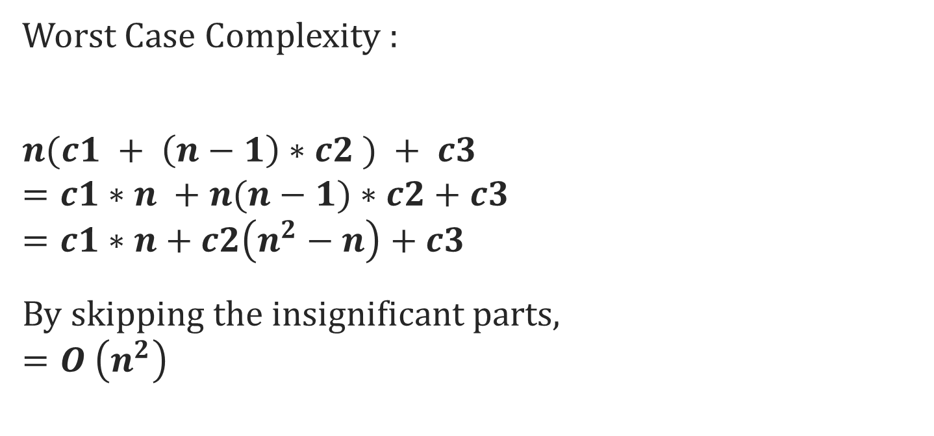
Number of machine instructions: n*{ c1 + (n-1)*c2 }+ c3
Worst Case Complexity :
$$n(c1 + \left(n−1\right)∗c2 ) + c3$$
$$=c1∗n +n(n−1)∗c2+c3$$
$$=c1∗n+c2\left(n^{2}−n\right)+c3$$
By skipping the insignificant parts,
$$=O \left(n^{2}\right)$$

Slide 16
for(j=1;j<n;j++){ | For loop (n) j<n Key=a[j] i=j-1 while loop (1) Best Case i>=0 && a[i]< key a[i+1] = a[i] i-- a[i+1]=key j++ Extra : j=1
key=a[j];
i=j-1;
while(i>=0 && a[i]< key){
a[i+1] = a[i];
i--;
}
a[i+1]=key;
}
Number of machine instructions: n*{ c1 + 1*c2 }+ c3

Slide 17
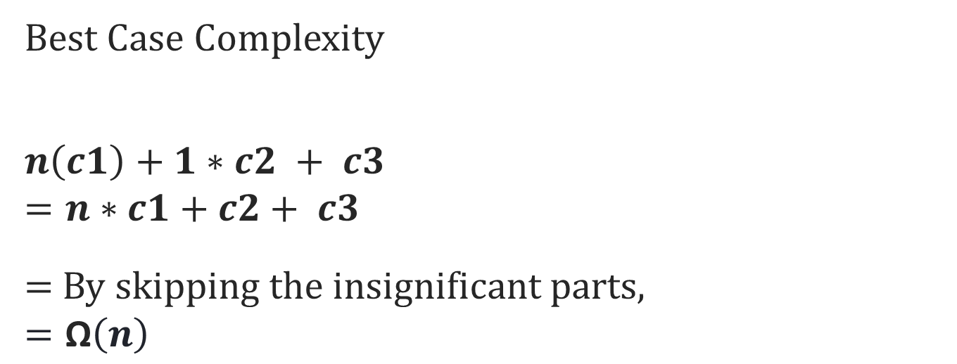
Number of machine instructions: n*{ c1 + 1*c2 }+ c3
Best Case Complexity
$$n\left(c1\right)+1∗c2 + c3$$
$$=n∗c1+c2+ c3$$
$=$By skipping the insignificant parts,
$$=\text{Ω}\left(n\right)$$

Slide 18

$Average Case$ Complexity
Average number of iterations in $while loop:$
= $\frac{1+2+3+ ………. +(n−1)}{(n−1)}$
= $\frac{\frac{n(n−1)}{2} }{(n−1)}$
= $\frac{n}{2}$

Slide 19

Number of machine instructions: n*{ c1 + $\frac{n}{2}$*c2 }+ c3
$$Average Case \text{Complexity}$$
$$n(c1 +\frac{n}{2}∗c2 ) + c3$$
$$=n∗c1 + {\frac{n}{2}∗n}^{ }∗c2+c3$$
= $n∗c1 +$($\frac{n^{2}}{2}) ∗c2+c3$
$$=θ\left({\left(\frac{n^{2}}{2}\right)}^{ }\right)$$
$$=θ\left({\left( n\right)}^{2}\right)$$

Slide 20
Selection Sort [Pseudocode]
Initializations and Inputs: int soa, int arr[ ].
Process:
Value of Starting index (starting_index) will be 0.
We will consider the starting index as the index (mini_index) containing the minimum element.
Value of Current index (current_index) will be starting_index + 1.
If, the element in current_index is less than the element in mini_index, the value of mini_index will be current_index.
Increase the value of current_index and repeat (4) for all the indexes.
Swap the elements in start_index and mini_index.
Increase the value of start_index and repeat (2) (3) (4) (5) (6) till start_index < soa-1.

Slide 21
Selection Sort [Algorithm]
void selectionSort(int arr[], int n)
{
int startIdx, currIdx, minIdx;
for (startIdx = 0; startIdx < n-1; startIdx ++){
minIdx = startIdx;
for (currIdx = startIdx +1; currIdx < n; currIdx ++){
if (arr[currIdx] < arr[minIdx]){
minIdx = currIdx;
}
}
if(minIdx!= startIdx){
swap(&arr[minIdx], &arr[startIdx]);
}
}
}

Slide 22
Selection Sort [Simulation]
i
= StartingIndex
j
= CurrentIndex
k
= MinimumIndex
i
i
i
i
i
i
i
i
i
j
j
j
j
j
j
j
j
j
11
22
66
22
33
66
44
55
77
33
66
11
77
91
77
88
91
55
91
33
99
88
99
44
k
k
k
k
k
k
k
k
k
k

Slide 23
Selection Sort Complexity Analysis

Slide 24
for (i = 0; i < n-1; i++){
minIdx = i;
for (curr = i+1; curr < n; curr++)
if (arr[curr] < arr[minIdx])
minIdx = curr;
if(minIdx!=i){
swap(&arr[minIdx], &arr[i]);
}
}

Slide 25
for (i = 0; i < n-1; i++){
minIdx = i;
for (curr = i+1; curr < n; curr++)
if (arr[curr] < arr[minIdx])
minIdx = curr;
if(minIdx!=i){
swap(&arr[minIdx], &arr[i]);
}
}
c1

Slide 26
for (i = 0; i < n-1; i++){
minIdx = i;
for (curr = i+1; curr < n; curr++)
if (arr[curr] < arr[minIdx])
minIdx = curr;
if(minIdx!=i){
swap(&arr[minIdx], &arr[i]);
}
}
c1
c2

Slide 27
for (i = 0; i < n-1; i++){ | Extra i=0
minIdx = i;
for (curr = i+1; curr < n; curr++)
if (arr[curr] < arr[minIdx])
minIdx = curr;
if(minIdx!=i){
swap(&arr[minIdx], &arr[i]);
}
}
c1
c2
c3

Slide 28
for (i = 0; i < n-1; i++){ | Extra i=0
minIdx = i;
for (curr = i+1; curr < n; curr++)
if (arr[curr] < arr[minIdx])
minIdx = curr;
if(minIdx!=i){
swap(&arr[minIdx], &arr[i]);
}
}
Number of machine instructions: (n-1)*{ c1 + n*c2 }+ c3

Slide 29
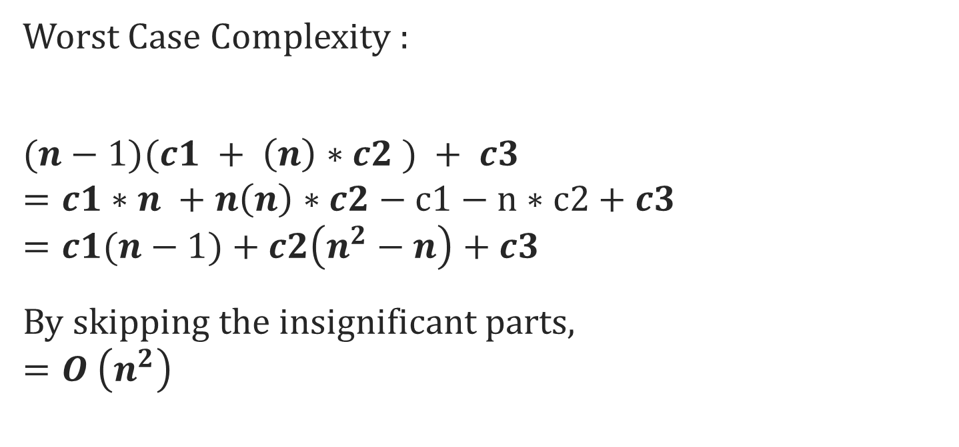
Number of machine instructions: (n-1)*{ c1 + n*c2 }+ c3
Worst Case Complexity :
$$(n−1)(c1 + \left(n\right)∗c2 ) + c3$$
$$=c1∗n +n\left(n\right)∗c2−c1−n∗c2+c3$$
$$=c1(n−1)+c2\left(n^{2}−n\right)+c3$$
By skipping the insignificant parts,
$$=O \left(n^{2}\right)$$

Slide 30
Number of machine instructions: (n-1)*{ c1 + n*c2 }+ c3
Class Task
Find out the Best & average Case Complexity using the above equation

Slide 31
Bubble Sorting
Concept:
Compare 1st two elements
If out of order, exchange them to put in order
Move down one element, compare 2nd and 3rd elements, exchange if necessary. Continue until end of array.
Pass through array again, exchanging as necessary
Repeat until pass made with no exchanges.

Slide 32
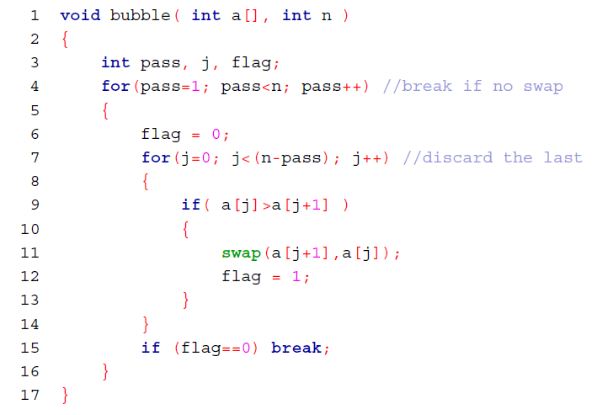
Bubble Sort [Algorithm]

Slide 33
An Animated Example
98
23
45
14
6
67
33
42
1 2 3 4 5 6 7 8

Slide 34
An Animated Example
98
23
45
14
6
67
33
42
1 2 3 4 5 6 7 8

Slide 35
An Animated Example
Swap
98
23
45
14
6
67
33
42
1 2 3 4 5 6 7 8

Slide 36
An Animated Example
Swap
23
98
45
14
6
67
33
42
1 2 3 4 5 6 7 8

Slide 37
An Animated Example
23
98
45
14
6
67
33
42
1 2 3 4 5 6 7 8

Slide 38
An Animated Example
Swap
23
98
45
14
6
67
33
42
1 2 3 4 5 6 7 8

Slide 39
An Animated Example
Swap
23
45
98
14
6
67
33
42
1 2 3 4 5 6 7 8

Slide 40
An Animated Example
23
45
98
14
6
67
33
42
1 2 3 4 5 6 7 8

Slide 41
An Animated Example
Swap
23
45
98
14
6
67
33
42
1 2 3 4 5 6 7 8

Slide 42
An Animated Example
Swap
23
45
14
98
6
67
33
42
1 2 3 4 5 6 7 8

Slide 43
An Animated Example
23
45
14
98
6
67
33
42
1 2 3 4 5 6 7 8

Slide 44
An Animated Example
Swap
23
45
14
98
6
67
33
42
1 2 3 4 5 6 7 8

Slide 45
An Animated Example
Swap
23
45
14
6
98
67
33
42
1 2 3 4 5 6 7 8

Slide 46
An Animated Example
23
45
14
6
98
67
33
42
1 2 3 4 5 6 7 8

Slide 47
An Animated Example
Swap
23
45
14
6
98
67
33
42
1 2 3 4 5 6 7 8

Slide 48
An Animated Example
Swap
23
45
14
6
67
98
33
42
1 2 3 4 5 6 7 8

Slide 49
An Animated Example
23
45
14
6
67
98
33
42
1 2 3 4 5 6 7 8

Slide 50
An Animated Example
Swap
23
45
14
6
67
98
33
42
1 2 3 4 5 6 7 8

Slide 51
An Animated Example
Swap
23
45
14
6
67
33
98
42
1 2 3 4 5 6 7 8

Slide 52
An Animated Example
23
45
14
6
67
33
98
42
1 2 3 4 5 6 7 8

Slide 53
An Animated Example
Swap
23
45
14
6
67
33
98
42
1 2 3 4 5 6 7 8

Slide 54
An Animated Example
Swap
23
45
14
6
67
33
42
98
1 2 3 4 5 6 7 8

Slide 55
After First Pass of Outer Loop
23
45
14
6
67
33
42
98
1 2 3 4 5 6 7 8

Slide 56
The Second “Bubble Up”
23
45
14
6
67
33
42
98
1 2 3 4 5 6 7 8

Slide 57
The Second “Bubble Up”
No Swap
23
45
14
6
67
33
42
98
1 2 3 4 5 6 7 8

Slide 58
The Second “Bubble Up”
23
45
14
6
67
33
42
98
1 2 3 4 5 6 7 8

Slide 59
The Second “Bubble Up”
Swap
23
45
14
6
67
33
42
98
1 2 3 4 5 6 7 8

Slide 60
The Second “Bubble Up”
Swap
23
14
45
6
67
33
42
98
1 2 3 4 5 6 7 8

Slide 61
The Second “Bubble Up”
23
14
45
6
67
33
42
98
1 2 3 4 5 6 7 8

Slide 62
The Second “Bubble Up”
Swap
23
14
45
6
67
33
42
98
1 2 3 4 5 6 7 8

Slide 63
The Second “Bubble Up”
Swap
23
14
6
45
67
33
42
98
1 2 3 4 5 6 7 8

Slide 64
The Second “Bubble Up”
23
14
6
45
67
33
42
98
1 2 3 4 5 6 7 8

Slide 65
The Second “Bubble Up”
No Swap
23
14
6
45
67
33
42
98
1 2 3 4 5 6 7 8

Slide 66
The Second “Bubble Up”
23
14
6
45
67
33
42
98
1 2 3 4 5 6 7 8

Slide 67
The Second “Bubble Up”
Swap
23
14
6
45
67
33
42
98
1 2 3 4 5 6 7 8

Slide 68
The Second “Bubble Up”
Swap
23
14
6
45
33
67
42
98
1 2 3 4 5 6 7 8

Slide 69
The Second “Bubble Up”
23
14
6
45
33
67
42
98
1 2 3 4 5 6 7 8

Slide 70
The Second “Bubble Up”
Swap
23
14
6
45
33
67
42
98
1 2 3 4 5 6 7 8

Slide 71
The Second “Bubble Up”
Swap
23
14
6
45
33
42
67
98
1 2 3 4 5 6 7 8

Slide 72
After Second Pass of Outer Loop
Finished second “Bubble Up”
23
14
6
45
33
42
67
98
1 2 3 4 5 6 7 8

Slide 73
The Third “Bubble Up”
23
14
6
45
33
42
67
98
1 2 3 4 5 6 7 8

Slide 74
The Third “Bubble Up”
Swap
23
14
6
45
33
42
67
98
1 2 3 4 5 6 7 8

Slide 75
The Third “Bubble Up”
Swap
14
23
6
45
33
42
67
98
1 2 3 4 5 6 7 8

Slide 76
The Third “Bubble Up”
14
23
6
45
33
42
67
98
1 2 3 4 5 6 7 8

Slide 77
The Third “Bubble Up”
Swap
14
23
6
45
33
42
67
98
1 2 3 4 5 6 7 8

Slide 78
The Third “Bubble Up”
Swap
14
6
23
45
33
42
67
98
1 2 3 4 5 6 7 8

Slide 79
The Third “Bubble Up”
14
6
23
45
33
42
67
98
1 2 3 4 5 6 7 8

Slide 80
The Third “Bubble Up”
No Swap
14
6
23
45
33
42
67
98
1 2 3 4 5 6 7 8

Slide 81
The Third “Bubble Up”
14
6
23
45
33
42
67
98
1 2 3 4 5 6 7 8

Slide 82
The Third “Bubble Up”
Swap
14
6
23
45
33
42
67
98
1 2 3 4 5 6 7 8

Slide 83
The Third “Bubble Up”
Swap
14
6
23
33
45
42
67
98
1 2 3 4 5 6 7 8

Slide 84
The Third “Bubble Up”
14
6
23
33
45
42
67
98
1 2 3 4 5 6 7 8

Slide 85
The Third “Bubble Up”
Swap
14
6
23
33
45
42
67
98
1 2 3 4 5 6 7 8

Slide 86
The Third “Bubble Up”
Swap
14
6
23
33
42
45
67
98
1 2 3 4 5 6 7 8

Slide 87
After Third Pass of Outer Loop
Finished third “Bubble Up”
14
6
23
33
42
45
67
98
1 2 3 4 5 6 7 8

Slide 88
Finished
6
14
23
33
42
45
67
98
1 2 3 4 5 6 7 8

Slide 89
Class Task
Find out the Worst, Best & average Case Complexity for Bubble sort

Slide 90
Books
Introduction to Algorithms, Thomas H. Cormen, Charle E. Leiserson, Ronald L. Rivest, Clifford Stein (CLRS).
Fundamental of Computer Algorithms, Ellis Horowitz, Sartaj Sahni, Sanguthevar Rajasekaran (HSR)

Slide 91
References
https://www.google.com/search?q=bubble+sort+step+by+step&sxsrf=ALeKk01uxzgfT3Oy6k1Q3WxVnSpiIN8_4g:1587999728942&tbm=isch&source=iu&ictx=1&fir=vRwFsGwVfJ6pJM%253A%252CSzhhze6MPQr4cM%252C_&vet=1&usg=AI4_-kSrEEXqwRL-PkHhVUtn7jNfF9dB6g&sa=X&ved=2ahUKEwje0Pz974jpAhXRAnIKHWhMD2UQ_h0wAXoECAcQBg#imgrc=EN4Sdu7veOWVoM&imgdii=eOqvCu85p9-eBM
https://www.interviewcake.com/concept/java/counting-sort
https://www.geeksforgeeks.org/counting-sort/
https://www.hackerearth.com/practice/algorithms/sorting/quick-sort/tutorial/

